Slide 1


COVID-19 Prediction Using Machine Learning
Muna PunCU6051NP – Artificial Intelligence
Autumn 2025
Informatics College Pokhara

Slide 2


AI Used
1
2
Supervised Learning
Regression Techniques
Uses labeled data to learn patterns and make predictions.
Uses two methods: Linear Regression for trends and Random Forest for stronger predictions.
3
Model Evaluation
Measured using MAE, RMSE, and MAPE metrics.

Slide 3

Research & Evidence
COVID-19 Data Analytics: WHO and Johns Hopkins datasets for analysis and prediction.
Model Effectiveness: ML models excel at short-term disease trend forecasting.
Supervised Learning in Healthcare: Proven methodology for disease trend prediction.
These established methods provide a strong foundation for the reliability and impact of our predictive model.

Slide 4




Why This Topic Matters
Methodology
Social Relevance
Full AI pipeline: data to visualization.
COVID-19 impact makes accurate prediction crucial for public health.
Practical Importance
Learning Opportunity
Enables healthcare planning and resource allocation.
Real-world AI application bridging theory and practice.

Slide 5
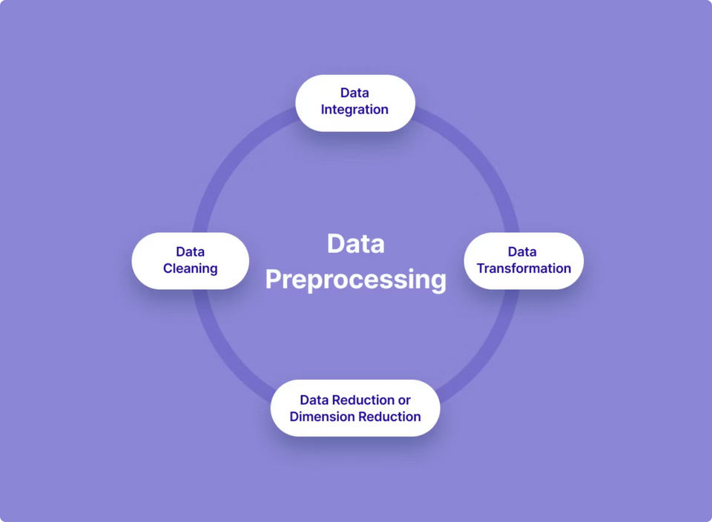
Our Solution: Predictive Application
User Input
Data Processing
User enters recent COVID-19 case data.
The system processes the input using trained machine learning models.
Trend Analysis
Case Prediction
The model analyzes trends from past data.
The system predicts next-day COVID-19 cases.
Informed Decisions
Results help in making early and informed decisions.

Slide 6
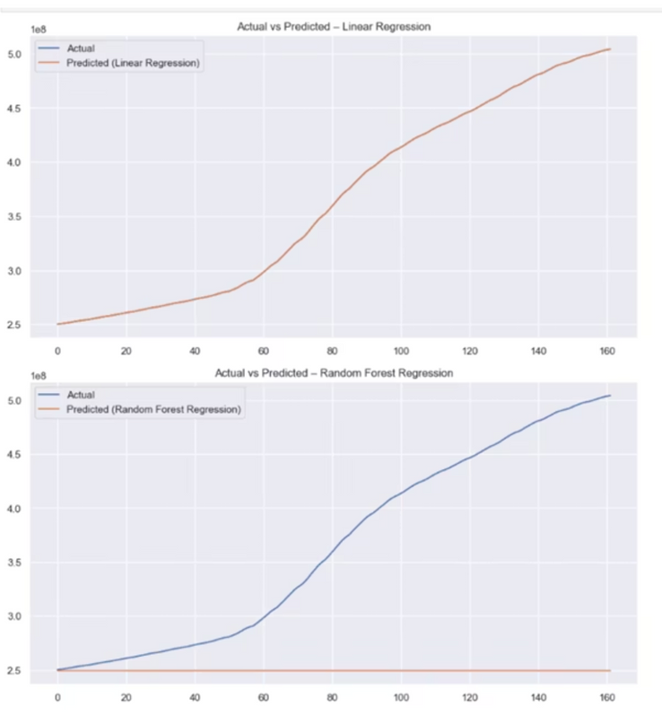


Results
Model Performance
Linear Regression provides more accurate and stable short-term predictions.
Linear Regression closely follows the actual COVID-19 case trend, showing very low MAE, RMSE, and MAPE.
Random Forest Regression shows larger deviation from actual values
Insights Gained
The model successfully identified rising and declining trends in COVID-19 cases, helping to better understand the progression and spread patterns over time

Slide 7
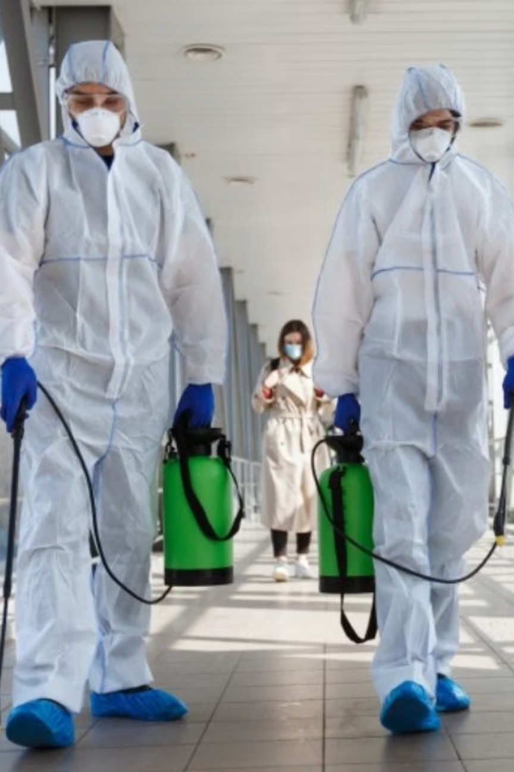



Real-World Impact & Applications
Healthcare Preparedness
Government Planning
Supports policy decisions and guides public health response.
Helps hospitals prepare for case surges and manage resources better.
Early Warning System
Alerts authorities early to prevent outbreak surges.

Slide 8
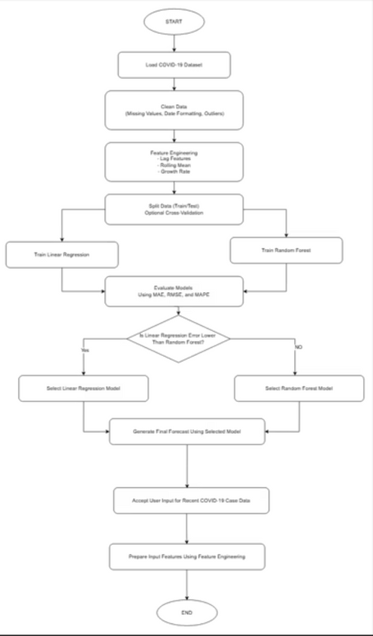
System Architecture: Flowchart
This flowchart illustrates the sequential steps involved in our COVID-19 prediction model, from raw data ingestion to final visualization of results.

Slide 9
Algorithmic Logic: Pseudocode
START
Load COVID-19 dataset
Clean and preprocess data
Generate time-series features (lag, rolling average, growth rate)
Split data into training and testing sets
Train Linear Regression and Random Forest models
Evaluate models using MAE, RMSE, and MAPE
Select the best-performing model
Accept recent COVID-19 case input
Prepare input features
Predict next-day COVID-19 cases
END
This pseudocode outlines the core computational logic behind our machine learning prediction system, detailing each major phase.

Slide 10

Thank You
Any Questions?

